Slide 1

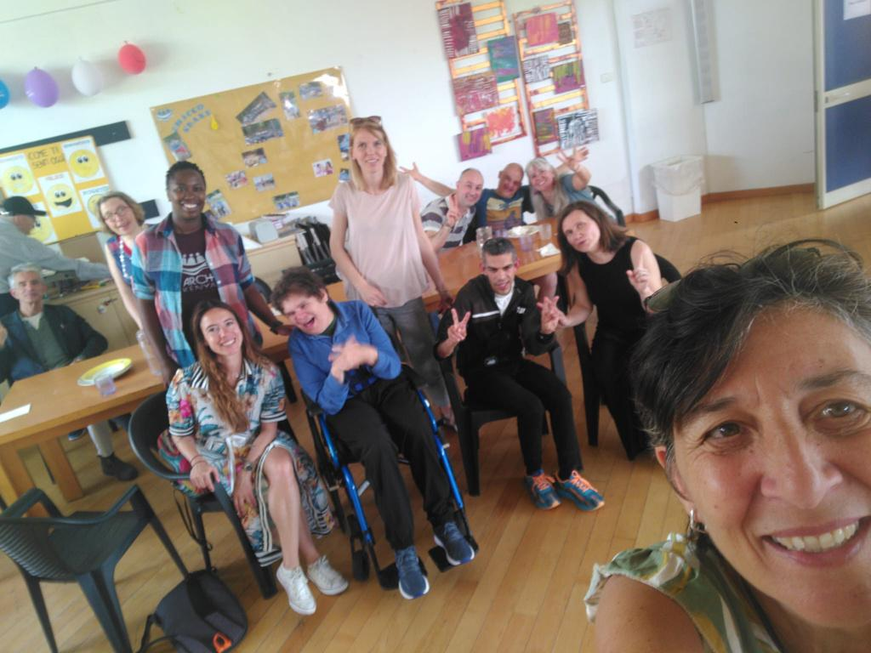



"After Us”
(Erasmus+ KA210)
Funded by the European Union. Views and opinions expressed are however those of the author(s) only and do not necessarily reflect those of the European Union or the European Education and Culture Executive Agency (EACEA). Neither the European Union nor EACEA can be held responsible for them.

Slide 2
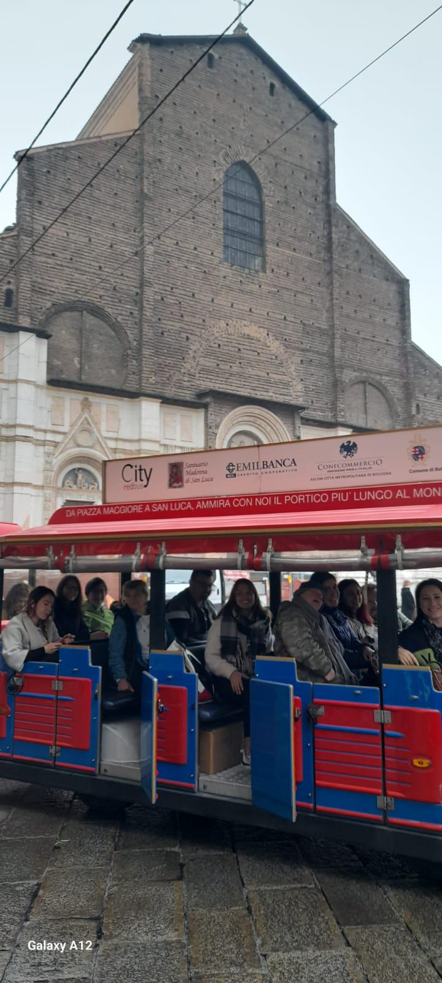
Project Context
Titolo:
Titolo del libro
Autore:
Nome dell’autore
Casa editrice:
Nome della casa editrice
Data di pubblicazione:
20XX
EU Erasmus+ project
The road to autonomy and wider inclusion for people with intellectual disabilities
Learning to cope with the separation from the family: After Us
Focus
Autonomy, inclusion, and dignity for adults with intellectual disabilities

Slide 3
Partners
Društvo Barka (Slovenia)
L’Arcobaleno (Bologna, Italy)
Il Chicco
(Rome, Italy)
Coordinated by Društvo Barka (Slovenia) with partners l’Arcobaleno (Bologna, Italy) and
Il Chicco (Rome, Italy)

Slide 4




Project Objectives
Support families and adults with intellectual disabilities in separation processes (from living home to living in L’Arche community)
Provide learning opportunities and psychoeducational materials for staff, volunteers, and families
Strengthen inclusion and community participation
Foster transnational cooperation and exchange of best practices between L’Arche communities

Slide 5
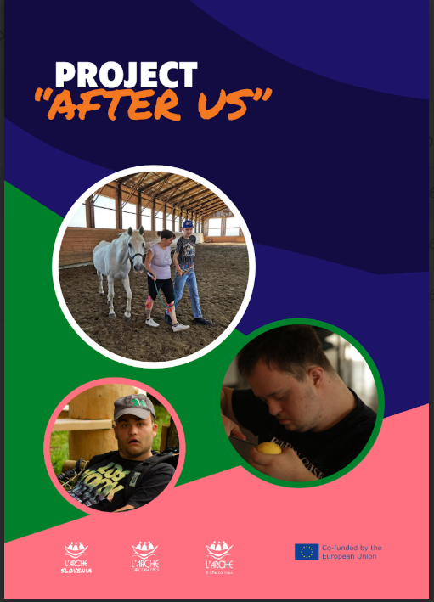
Learning Material on separation
Multilingual resource material (English, Italian, Slovenian) developed by Il Chicco, with input from Društvo Barka and L’Arcobaleno
Contains open letters to core members, families, and assistants
Reflections on attachment theory and separation anxiety
Practical guidelines for navigating transitions
Main point: There is no “one size fits all” solution
Companion tool, not a manual – designed for empathy and support

Slide 6
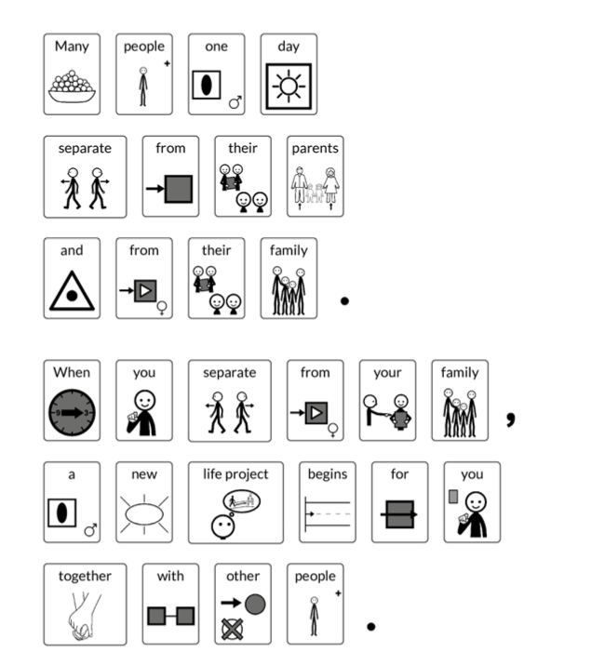
Aumentative Alternative Communication (AAC)

Slide 7
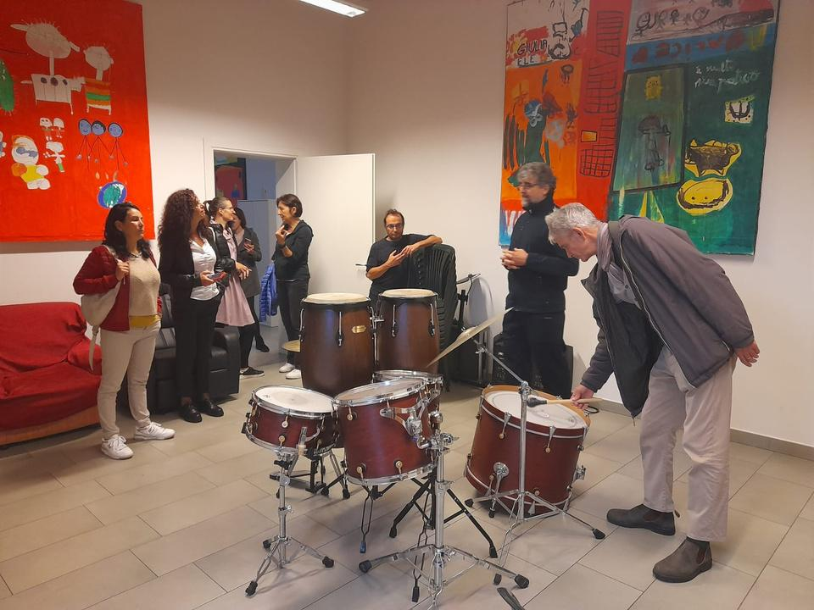
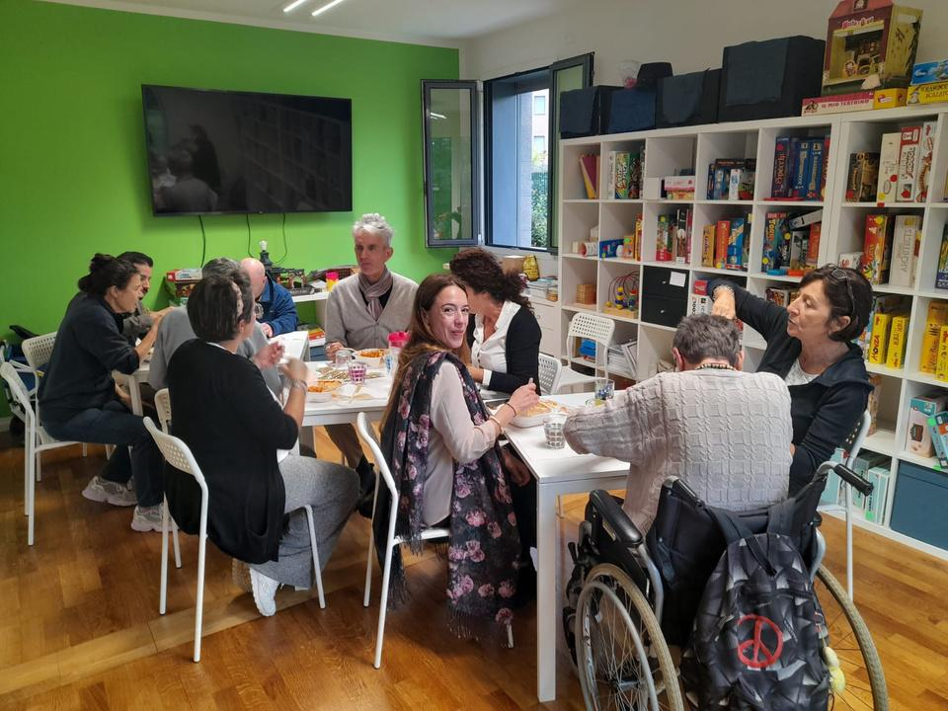
Learning Material on separation
(situations addressed)
Transition from family home to residential living
Attending day programmes/ workshops outside family environment
Overnight stays for holidays, trips, or events (e.g., Special Olympics)
Loss and grief (death of a parent, assistant, or community member)
Moving between L’Arche homes/programmes due to changing needs

Slide 8
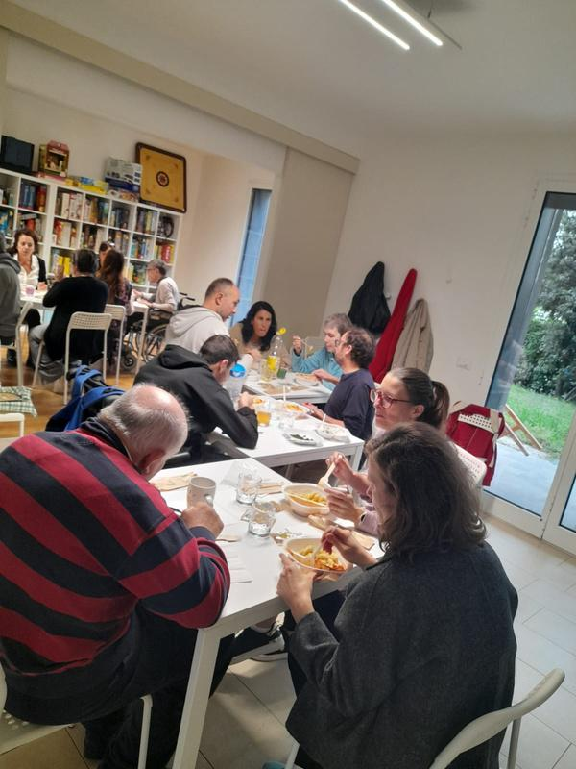
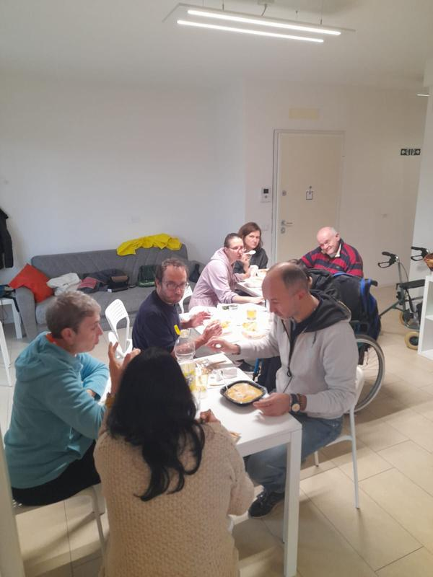
01
Training sessions for assistants, families, and volunteers in Bologna, Rome and Zbilje
Training & Accompaniment
02
Focus on emotional, psychological, and practical aspects of separation
03
Emphasis on building trust, communication, and resilience
04
Shared experiences across communities to strengthen collective learning

Slide 9
Key Learnings
Separation is both necessary and deeply emotional
Families experience worry, guilt, and mistrust – need accompaniment
Adults with intellectual disabilities face anxiety, loss of routines, and new challenges
Assistants must balance professional care with empathy and personal history
Inclusion begins with listening and understanding

Slide 10
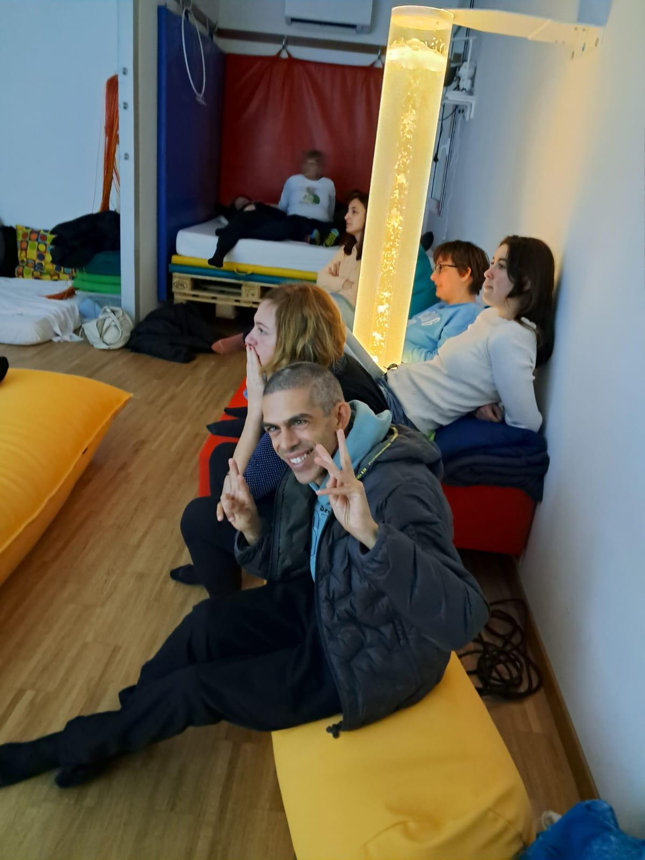
Why It Matters
Deinstitutionalization is an EU priority, but requires human-centered support
Adult education is not only about skills – it’s about life transitions
“After Us” offers adaptable resources for communities across Europe
Sharing ensures broader impact and sustainability

Slide 11
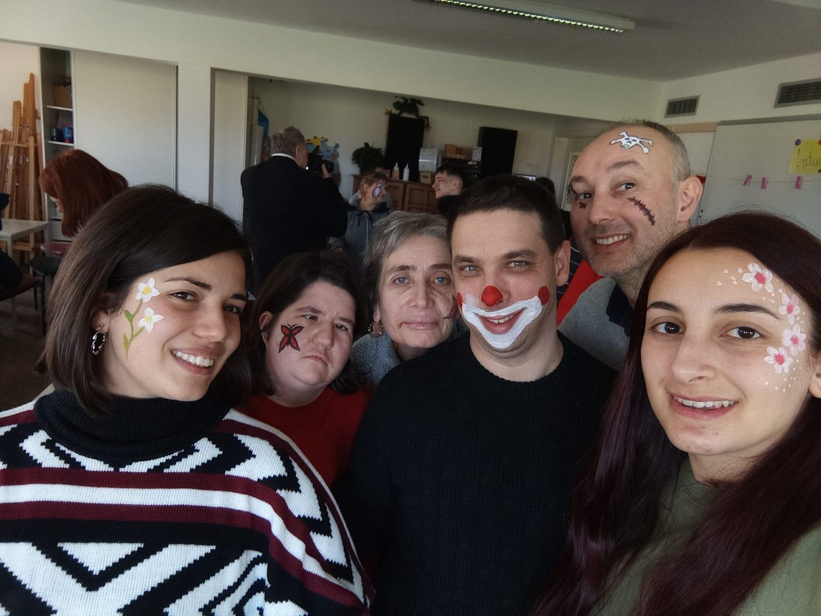

Slide 12
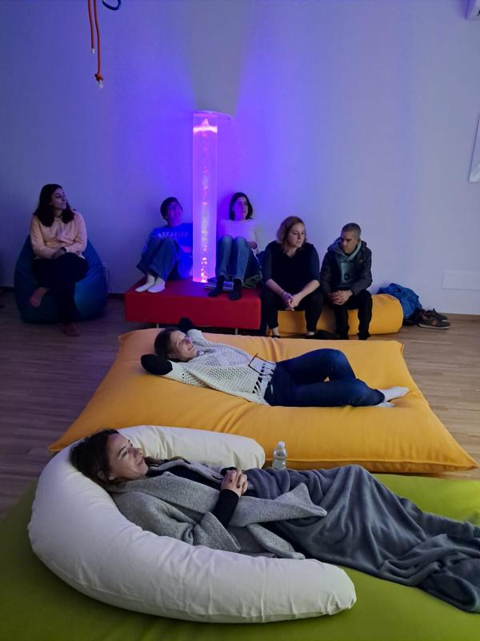
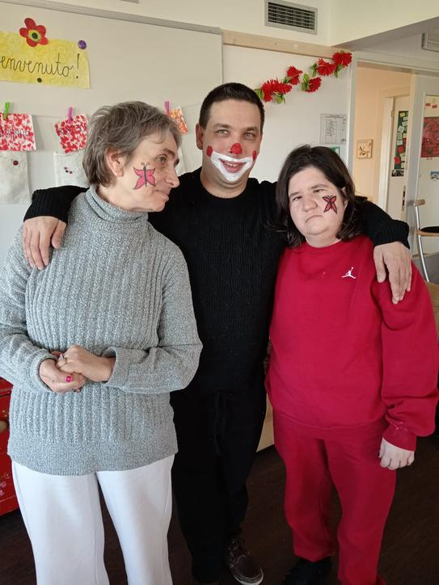
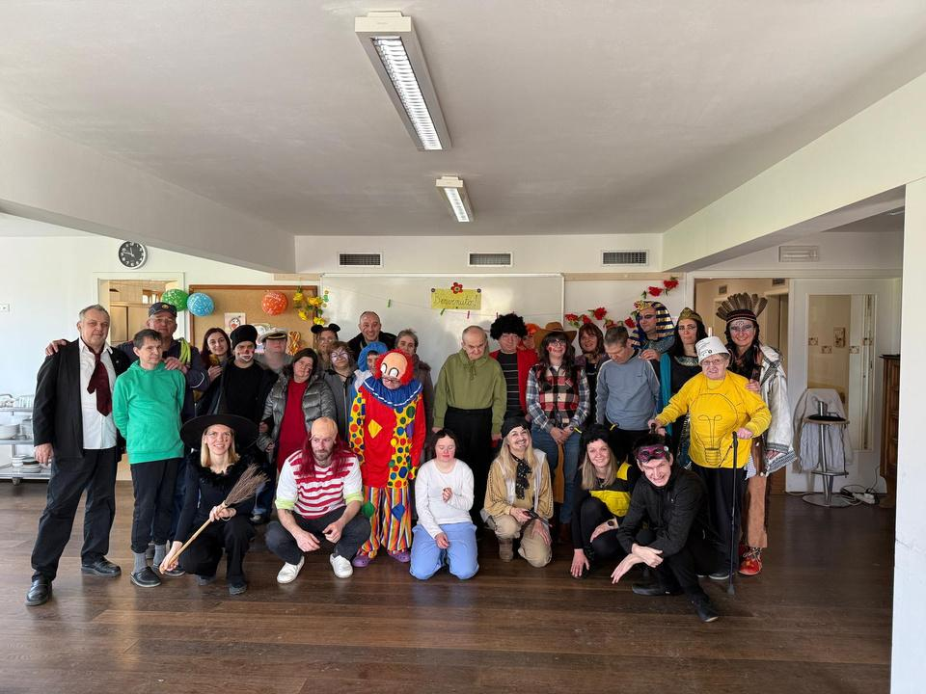
Project activities
Kick-off meeting & visiting the community in Rome
Training for assistants & visiting the community in Bologna
Active holidays & visiting the community in Slovenia
Theater workshop in Rome
Pizza Lab in Bologna
Active holidays in Bologna

Slide 13


LEARNING MATERIAL

Slide 14
